Slide 1


Mba programmeS
Prof. Nayantara Padhi
School of Management Studies
IGNOU

Slide 2
Key Changes and Developments
AICTE APPROVED
UPTO DATE COURSE CONTENT
Affordable Fees
IGNOUMBA
CHANGE IN ELIGIGIBITY CRITERIA
CONTEMPORARY PROGRAMME STRUCTURE
Mode-ODL & Online
New Sepcialisation

Slide 3
7 MBA Programmes
MBA(through Online mode)
With 5 specialisations
MBA in Human Resource Management
MBA in Operations Management
Human Resource Management
Financial Management
Operations Management
Marketing Management
Services Management (Newly introduced)
MBA in Financial Management
MBA in Marketing Management
04
05
03
06
02
MBA (through ODL/distance mode)
MBA ( Banking & Finance )
01
07

Slide 4
ELIGIBILITY CRITERIA
01
Passed any Bachelor Degree with Minimum 3 years duration and at least 50% marks (45% in case of candidates belonging to reserved category).
02
Qualifying in OPENMAT or any
other entrance test not required
03
Experience not required

Slide 5
PROGRAMME FEATURES
MBA
01 | Seven Courses in each Semester
02 | Four Semesters
03 | Duration : Minimum Two Years Maximum Four Years
04 | In order to get an MBA degree a student has to complete 28 courses as follows: Twenty (20) Core courses and Seven (07) specialisation courses One (01) Project course
05 | Exit Point: PGDIM (on demand from the student) on completion of 14 courses of first two semesters
06 | 28 Courses and 116 Credits
07 | Semester Wise Registration

Slide 6
Programme Structure
Semester 1
Semester 2
MMPC 001
MMPC 002
MMPC 003
MMPC 004
MMPC 005
MMPC 006
MMPC 007
MMPC 008
MMPC 009
MMPC 010
MMPC 011
MMPC 012
MMPC 013
MMPC 014
Success
Semester 3
Semester 4
MMPC 015
MMPC 016
MMPP 001
(Project)
Spcecialisation course 1
Spcecialisation course 2
Spcecialisation course 3
Spcecialisation course 4
MMPC 017
MMPC 018
MMPC 019
MMPC 020
Spcecialisation course 5
Spcecialisation course 6
Spcecialisation course 7

Slide 7
SEMESTER 1
 | Course code |  | Course Title | Credit Weightage
 | MMPC-001 |  | Management Functions And Behaviour | 4
 | MMPC -002 |  | Management Of Human Resources | 4
 | MMPC -003 |  | Business Environment | 4
 | MMPC -004 |  | Accounting For Managers(New) | 4
 | MMPC -005 |  | Management Of Machines And Materials | 4
 | MMPC -006 |  | Marketing For Managers | 4
 | MMPC-007 |  | Business Communication (New) | 4

Slide 8
SEMESTER 2
 | Course code |  | Course Title | Credit Weightage
 | MMPC -008 |  | Information Systems For Managers | 4
 | MMPC -009 |  | Quantitative Analysis For Managerial Applications | 4
 | MMPC-010 |  | Managerial Economics | 4
 | MMPC-011 |  | Social Process and Behavioural Issues | 4
 | MMPC-012 |  | Strategic Management | 4
 | MMPC-013 |  | Business Laws (New) | 4
 | MMPC-014 |  | Financial Management | 4

Slide 9
SEMESTER 3
 | Course code |  | Course Title | Credit Weightage
 |  |  | CORE COURSES
 | MMPC -015 |  | Research Methodology for Management Decisions | 4
 | MMPC -016 |  | International Business Management | 4
 | MMPP-001 |  | Project Course | 8
 |  |  | Specialisation Courses (any 4 from any one of the areas of specialisation):
 |  |  |  | 4
 |  |  |  | 4
 |  |  |  | 4
 |  |  |  | 4

Slide 10
SEMESTER 4
 | Course code |  | Course Title | Credit Weightage
 |  |  | CORE COURSES
 | MMPC -017 |  | Advanced Strategic Management | 4
 | MMPC -018 |  | Entrepreneurship (New) | 4
 | MMPC-019 |  | Total Quality Management | 4
 | MMPC-020 |  | Business Ethics (New) | 4
 |  |  | Specialisation Courses (any 3 from any one of the areas of specialisation):
 |  |  |  | 4
 |  |  |  | 4
 |  |  |  | 4
 |  |  | Total no. Of Credits in the programme (28+28+32+28) | 116

Slide 11
List of Area-wise Specialization Courses (7 Courses to be selected, four in 3rd and three in 4th Semester): HUMAN RESOURCE MANAGEMENT SPECIALISATION
Course code | Course Title
MMPH-001 | Organisational Design, Development and Change
MMPH-002 | Human Resource Development
MMPH-003 | Human Resource Planning
MMPH-004 | Industrial Relations
MMPH-005 | Managing Change in Organisations
MMPH-006 | Organisational Dynamics
MMPH-007 | Compensation and Reward Management
MMPH-008 | Labour Laws
MMPH-009 | International Human Resource Management

Slide 12
List of Area-wise Specialization Courses (7 Courses to be selected, four in 3rd and three in 4th Semester); FINANCIAL MANAGEMENT SPECIALISATION
Course code | Course Title
MMPF-001 | Working Capital Management
MMPF-002 | Capital Investment and Financing Decision
MMPF-003 | Management Control Systems
MMPF-006 | Management of Financial Services
MMPF-007 | Equity Markets
MMPF-004 | Security Analysis and Portfolio Management
MMPF-005 | International Financial Management
MMPF-008 | Equity Derivatives
MMPF-009 | Commodity Markets
MMPF-010 | Currency and Debt Markets
MMPF-011 | Management of Insurance Services

Slide 13
List of Area-wise Specialization Courses (7 Courses to be selected, four in 3rd and three in 4th Semester) OPERATIONS MANAGEMENT SPECIALISATION
Course code | Course Title
MMPO-001 | Operations Research
MMPO-002 | Project Management
MMPO-003 | Production/ Operations Management
MMPO-005 | Logistics and Supply Chain Management
MMPO-004 | Management Information System
MMPO-006 | Material Management
MMPO-507 | Maintenance Management
MMPO-508 | Management of R&D and Innovation
MMPO-509 | International Logistics Management

Slide 14
List of Area-wise Specialization Courses (7 Courses to be selected, four in 3rd and three in 4th Semester) MARKETING MANAGEMENT SPECIALISATION
Course code | Course Title
MMPM-001 | Consumer Behaviour
MMPM-002 | Sales Management
MMPM-003 | Product Management
MMPM-005 | Marketing of Services
MMPM-004 | International Marketing
MMPM-006 | Marketing Research
MMPM-008 | Management of Marketing Communication and Advertising
MMPM-011 | Rural Marketing
MP-012 | Retail Marketing

Slide 15
List of Area-wise Specialization Courses (7 Courses to be selected, four in 3rd and three in 4th Semester) Services Management (New) SPECIALISATION
Course code | Course Title
MMPH-002 | Human Resource Development
MMPO-005 | Logistics and Supply Chain Management
MMPF-006 | Management of Financial Services
MMPM-005 | Marketing of Services
MMPM-012 | Retail Marketing
MMPF-012 | Marketing of Financial Services
MMPF-011 | Management of Insurance Services

Slide 16
Admission Process
01
02
03
Online application
Fixed number of courses in each semester
The registration will be semester-wise and the validity of each course would expire on completion of the maximum duration of the programme i.e. 4 years
Candidates can directly take admission without entrance test and prior experience
04
05
The courses will be offered semester wise
Each semester will have fixed courses on offer

Slide 17
Fees
Total Programme Fee is INR.62,000/-
(15500/- each semester)
Assignments
All the assignments will be valid for 1 year i.e 2 semesters
Exit Option
PGDIM (on demand from the student) on completion of 14 courses of first two semesters
MBA ON COMPLETION OF 28 COURSES INN FOUR SEMESTERS

Slide 18
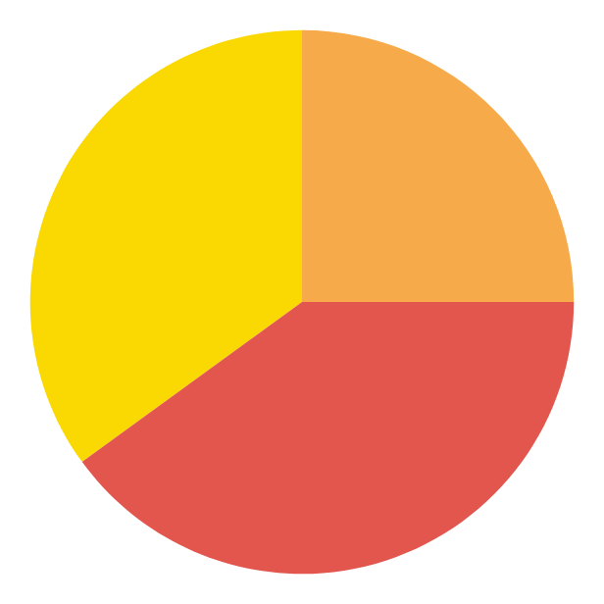
MBA (Banking & Finance) PROGRAMME
PROGRAMME CODE:MBF
ELIGIBILITY
Passed Bachelor Degree with Minimum 3 years duration and at least 50% marks (45% in case of candidates belonging to reserved category);
Should have passed the CAIIB examinations of the Indian Institute of Banking & Finance, Mumbai, and awarded the requisite qualification/credentials thereof by the Institute; and
Should have been working with the banking or financial services sector for a period of at least two years.

Slide 19
Programme Structure
Semester 1
Semester 2
MMPC 001
MMPC 002
MMPC 003
MMPC 004
MMPC 005
MMPC 006
MMPC 007
MMPC 008
MMPC 009
MMPC 010
MMPC 011
MMPC 012
MMPC 013
MMPC 014
Success
Semester 3
Semester 4
MMPC 015
MMPC 016
MMPP 001 (Project)
Spcecialisation course 1
Spcecialisation course 2
Spcecialisation course 3
Spcecialisation course 4
MMPC 017
MMPC 018
MMPC 019
MMPC 020
Spcecialisation course 5
Spcecialisation course 6
Spcecialisation course 7

Slide 20
SPECIALISATION COURSES
Course code | Course Title | Credit Weightage
MMPF 006 | Management of financial Services | 4
MMPB 001 | Bank Financial Management | 4
MMPB 002 | International Banking Management | 4
MMPB 003 | Electronic Banking and IT in Banks | 4
MMPB 004 | Risk management in Banks | 4
MMPB 005 | Marketing of Financial Services | 4
MMPF 011 | Management of Financial Services | 4
MMPB 006 | Ethics and Corporate Governance in Banks | 4

Slide 21
MBA in HRM/FM/MM/OM
Eligibility
and
Admission
Same as MBA programmes

Slide 22
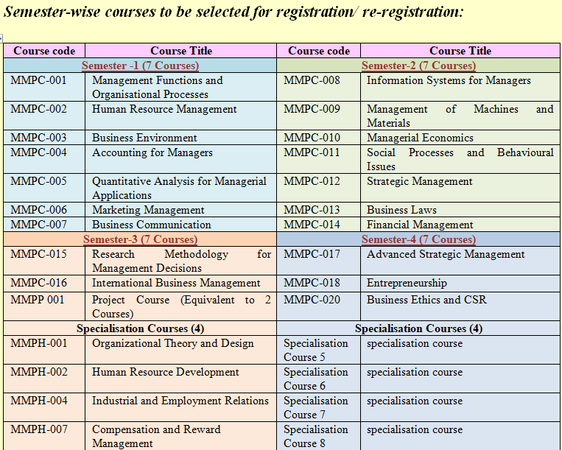
Programme Structure-MBAHM

Slide 23
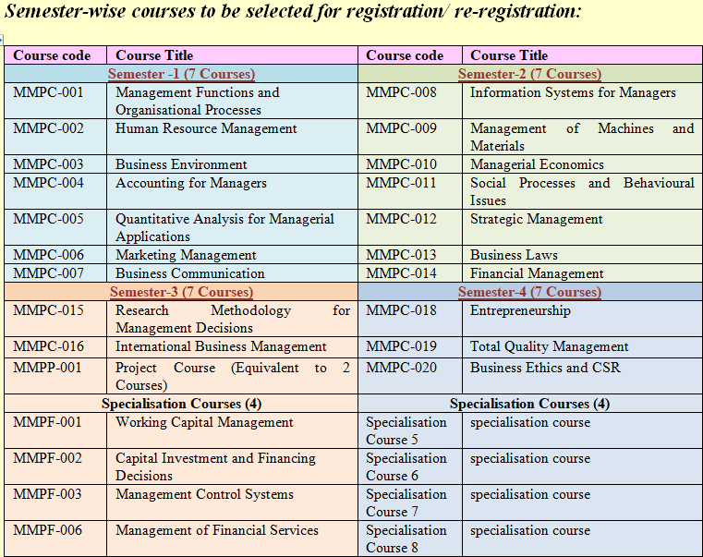
Programme Structure-MBAFM

Slide 24
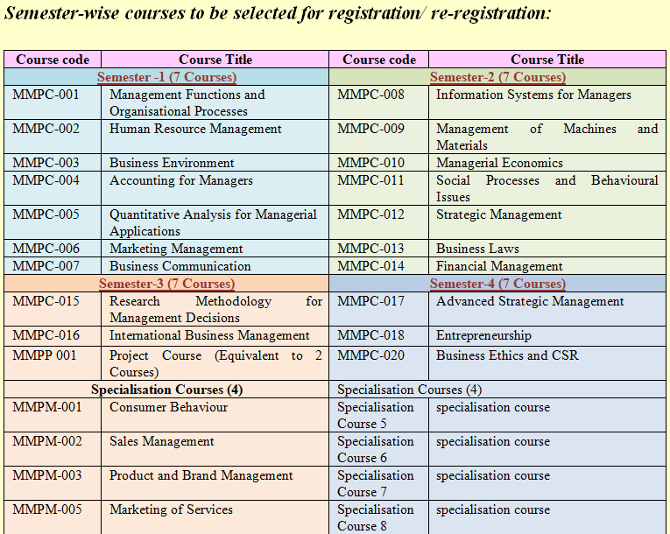
Programme Structure-MBAMM

Slide 25
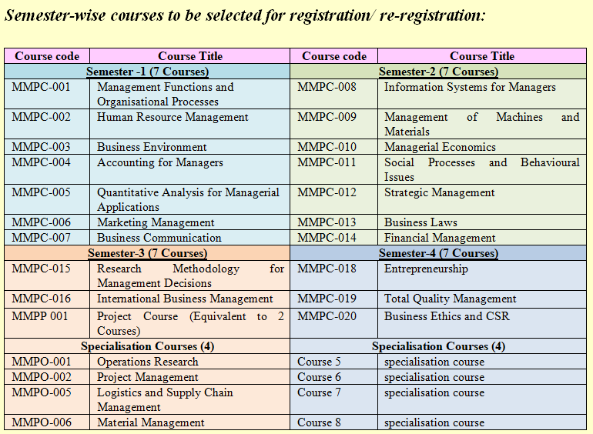
Programme Structure-MBAOM

Slide 26
Thank You

